Slide 1
Computer gyan mela

Slide 2
What is an Artificial Intelligence (AI) ?
Artificial Intelligence (AI) is a broad branch of computer science that tries to make the machine to perform rational behaviour. The goal of AI is to perform tasks in a human-like behaviour. AI manifests itself in everyday life via virtual assistants, search prediction technology, and even ride-hailing services.

Slide 3
ANCIENT LANGUAGE
An ancient language is any language originating in times that may be referred to as ancient. There are no formal criteria for deeming a language ancient, but a traditional convention is to demarcate as "ancient" those languages that existed prior to the 5th century.
In its literary sense, language refers to a system of communication through speech, a collection of sounds that a group of people interpret to have the same meaning.

Slide 4
The fact that Sanskrit was codified in Panini's grammar in non-metrical stress around 500 BCE, and that Tolkappiyanar's grammar of Tamil dates from around the beginning of the CE, and that students can still learn Sanskrit and Tamil at the feet of pundits using time-honoured rote methods devised millennia ago.

Slide 5
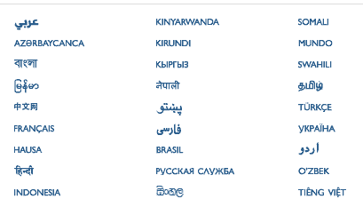
SOME ANCIENT LANGUAGE

Slide 6
ai

Slide 7
HOW DOES OUR AI Works
We used many modules to make an AI to study about ancient language.
Our AI can information on ancient language and can use a Wikipedia. To give information.

Slide 8
AI Commands
Input | Output
Play the video | (plays the video) Playing the video
What can you do? | I can give info on ancient languages I can use Wikipedia to give info
Wikipedia “x” | Summary of “x”
Hello | Hello sir, may I Help you with something
How are you | I am fine sir
Thank you | Its my pleasure sir
Rest | I a

Slide 9
CREDITS
BS SHREYAS - CODE DEVELOPER
VINEET.P - PRESENTATION DEVELOPER
NIKHIL DEEPAK - PRESENTATION DEVELOPER
JAYANT - CODE DEVELOPER

Slide 10
WHAT DID YOU UNDERSTAND ?
1.what is an AI ?
2. What are ancient language ?

Slide 11


